Slide 1
Linkage
THU CST 63 Kang Hongbo

Slide 2
Why
Annoying

Slide 3
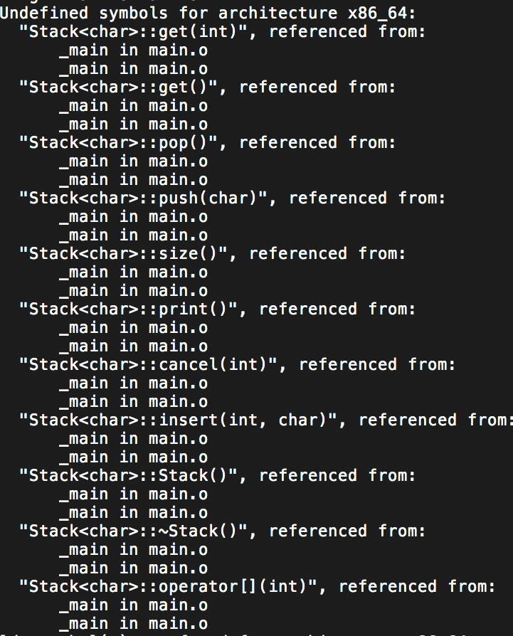

Slide 4
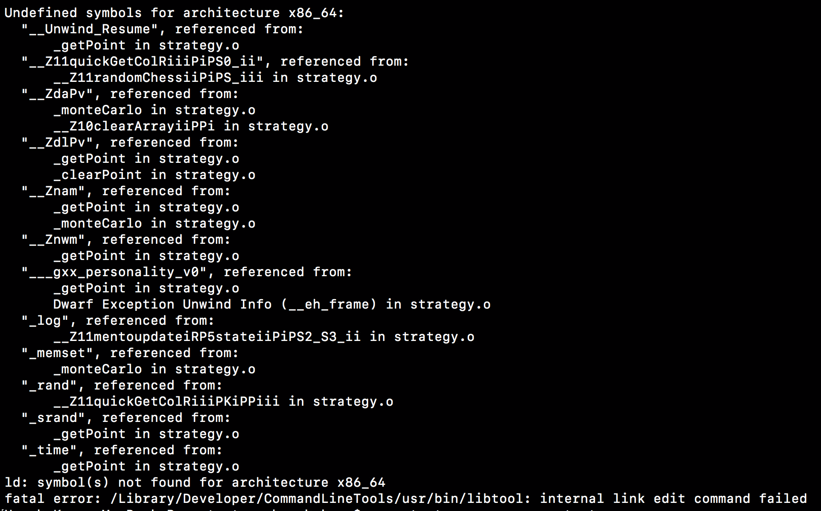

Slide 5
 |  | C++

Slide 6
Definition
Linkage
Template

Slide 7
Definition & Declaration
Definition & Declaration
int a = 2;
extern int a;
void foo();
void foo() {};

Slide 8
Definition & Declaration
Definition & Declaration
int a = 2;
A 0x233333 2
Assign a place

Slide 9
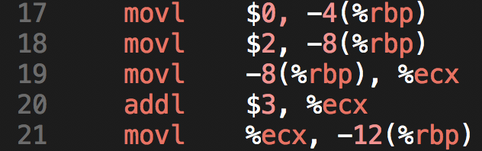
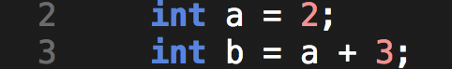
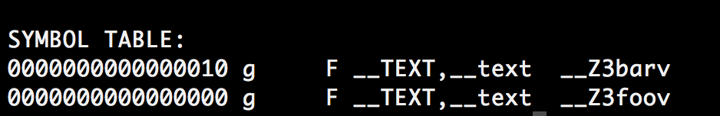

Slide 10
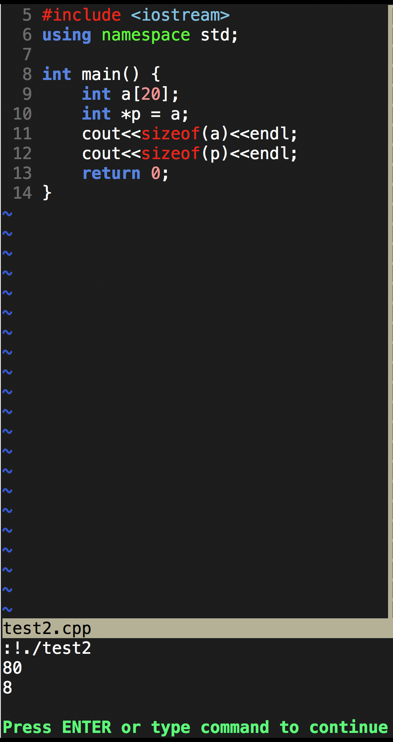
Symbol
Pointer
&
Array

Slide 11
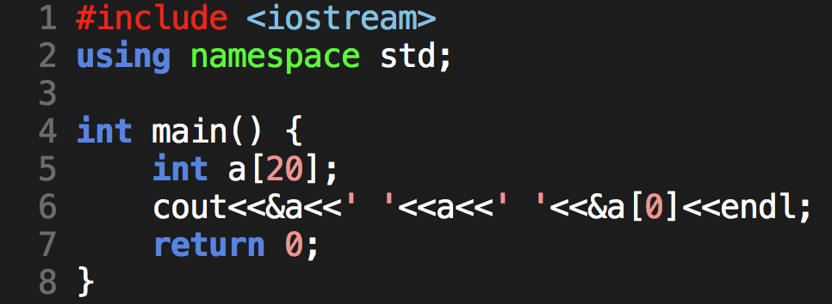

Slide 12
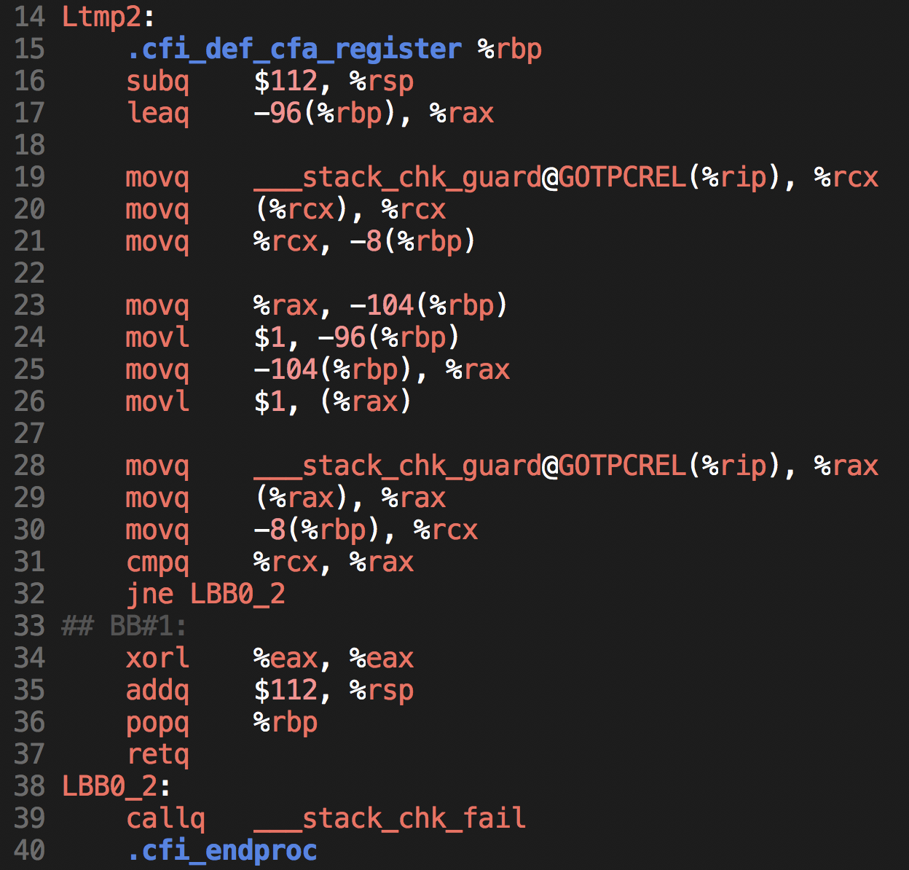
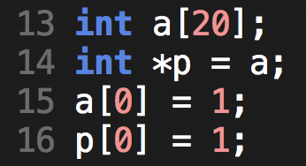

Slide 13
Linkage
Linkage bases on symbol

Slide 14
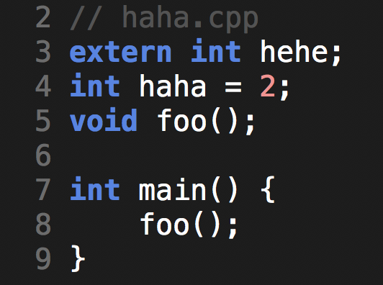
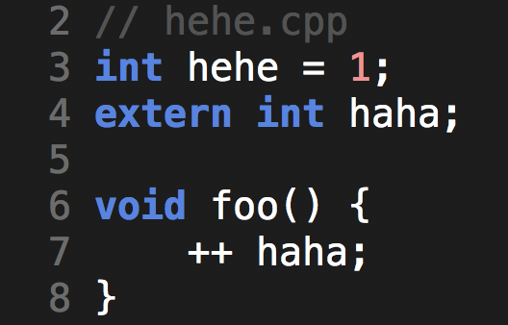

Slide 15
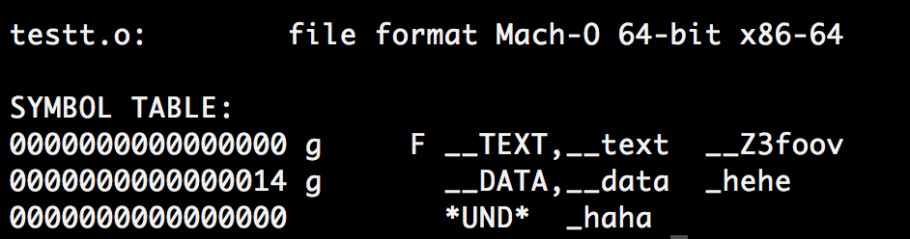
地址 | 符号 | 长度?
0x232 | Hehe | 4
0x233 | Foo | ??
Exported(?) Symbol Table

Slide 16
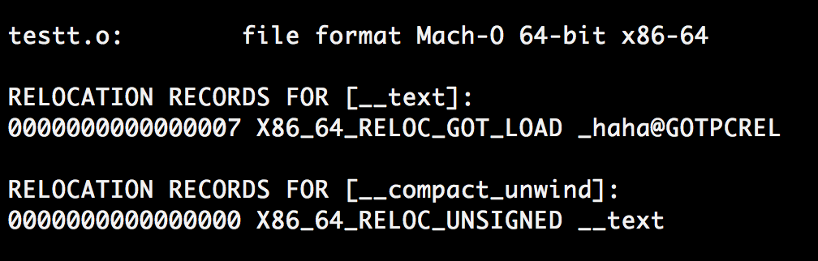
地址 | 符号 | 长度?
0x000 | Haha | 4
Undefined Symbol Table

Slide 17
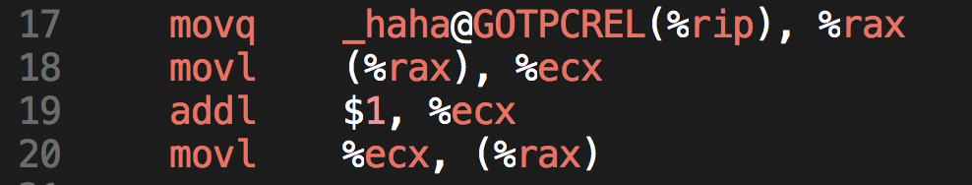
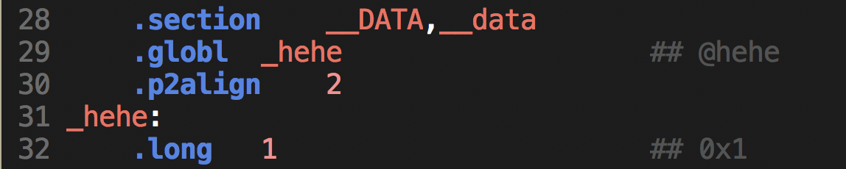

Slide 18
Unused variables might be ignored while compiling

Slide 19
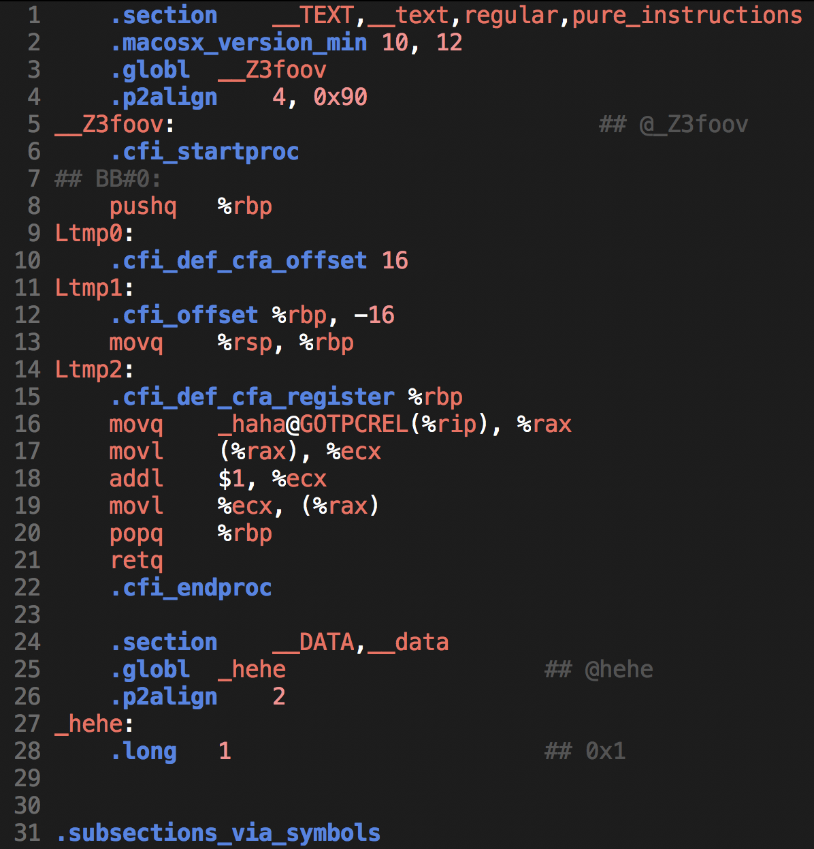

Slide 20
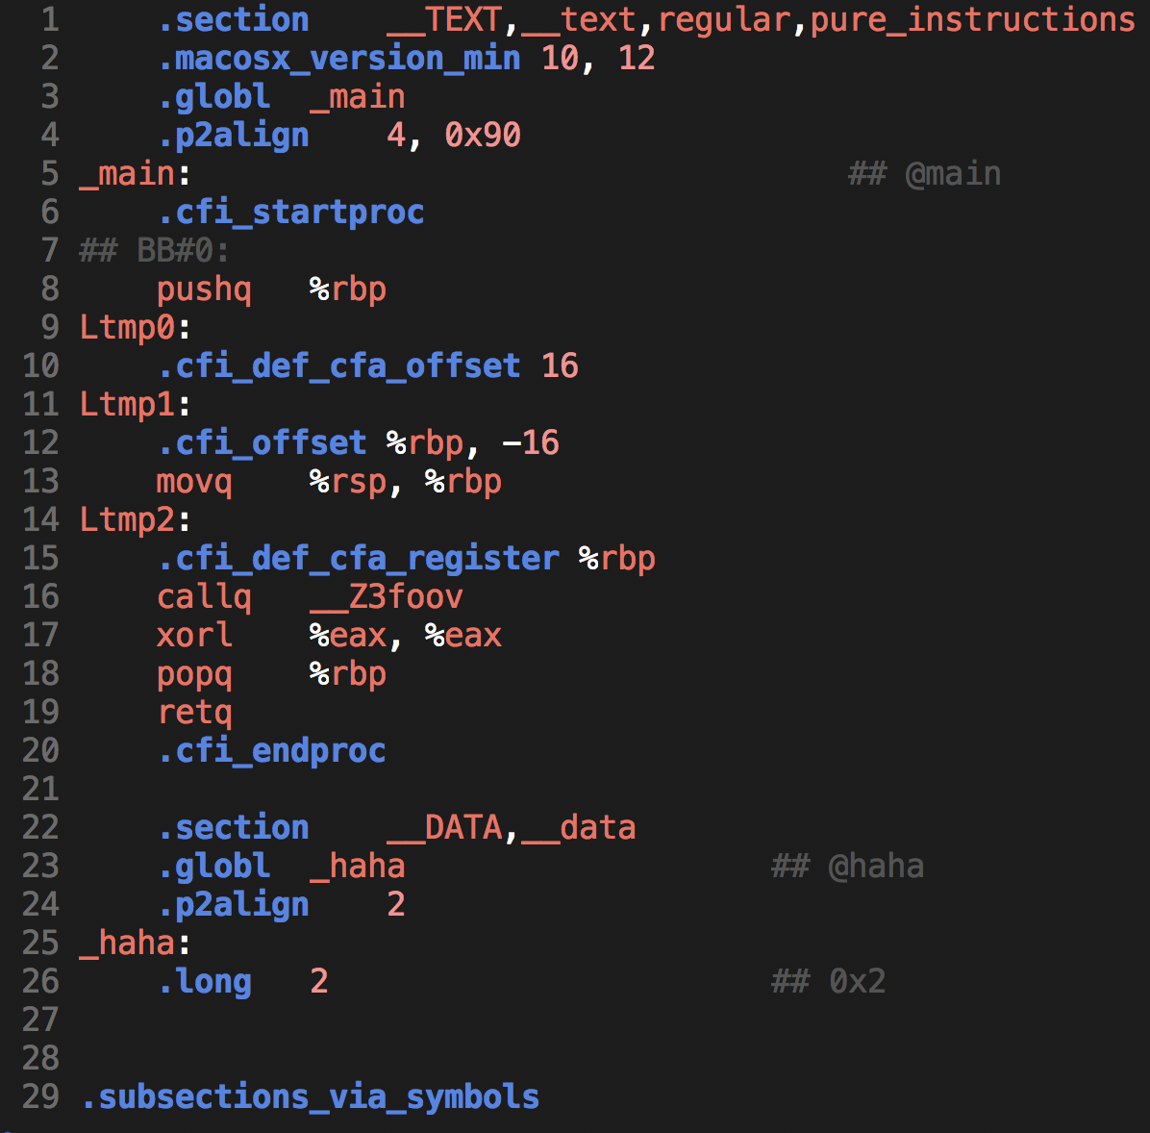

Slide 21
搞事
Linkage bases on symbol

Slide 22
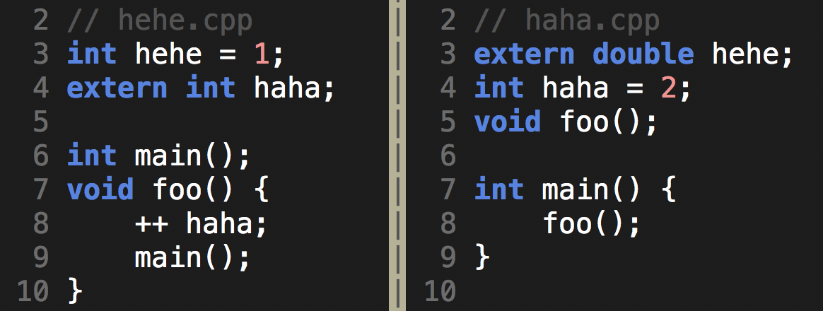

Slide 23
Link Error
Redefined
Undefined

Slide 24
Linkage & Include
Why we need #ifdef 233_H

Slide 25
Linkage & Include
Why we need #ifdef 233_H
Redefinition not permitted

Slide 26
Linkage & Include
Why we need #ifdef 233_H
Redefinition not permitted
so it’s possible if there’s no definitions

Slide 27
Internal Linkage
• 加 static 前缀的全局变量定义.如: static int x;
• 枚举类型的定义.如: enum Boolean {NO,YES };
• 类的定义. 如: class Point { int d_x; int d_y; ... };
• 内联函数的定义.如: inline int operator==(const Point& left, const Point&right) { ... }
• union的定义.
• 名字空间中const常量定义（const in name spaces)

Slide 28
External Linkage
• 非内联的类成员函数.如: Point& Point::operator+= (const Point& right) { ... }
• 非内联,非静态的自由函数. 如: Point operator+(const Point& left, const Point& right) { ... }
• 非静态的全局定义. int a;

Slide 29
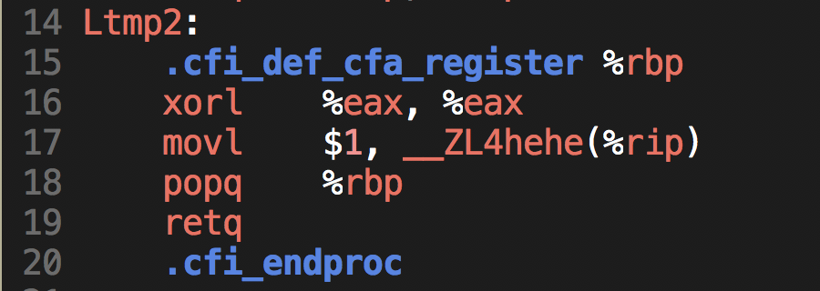
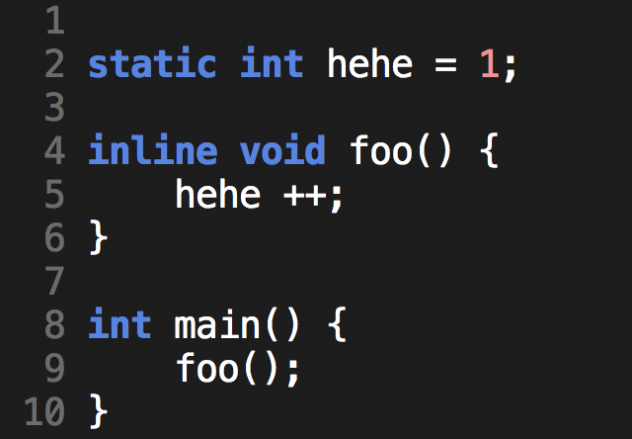
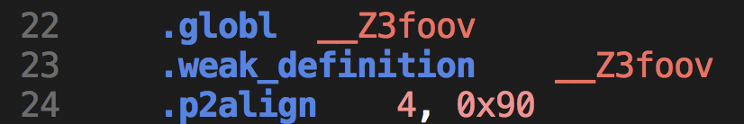
Weak Definition
inline functions
&
#define

Slide 30
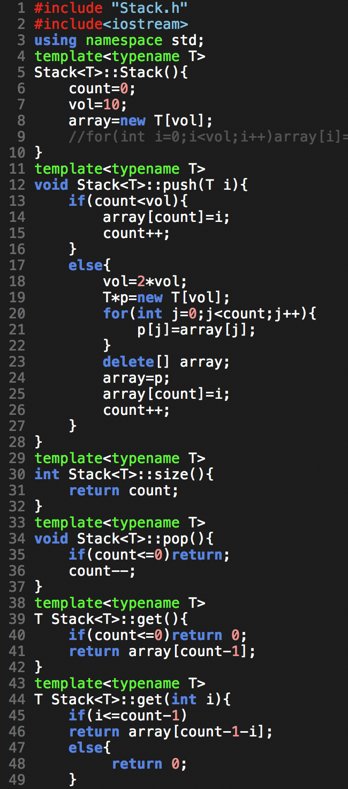
Template
Small trick

Slide 31
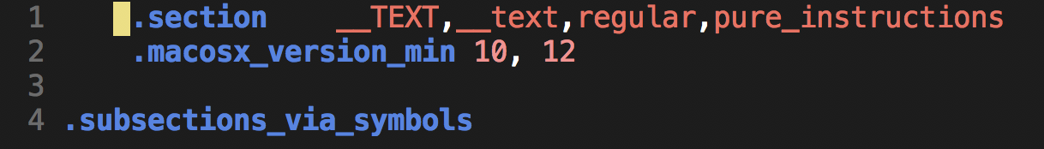

Slide 32
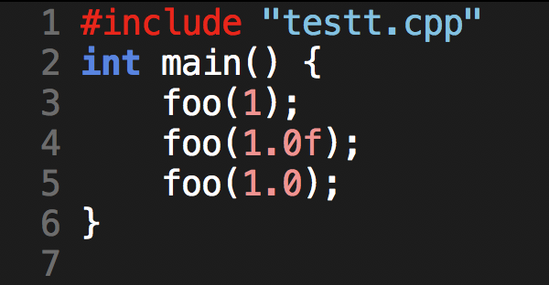
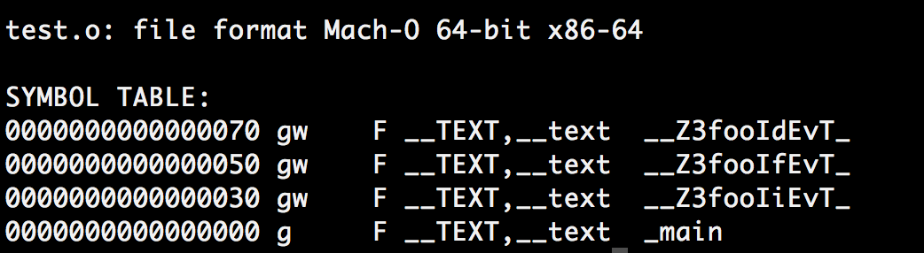

Slide 33
https://www.ibm.com/developerworks/cn/linux/l-dynlink/
–Dynamic Linkage?

